Slide 1
Transport
Year 11 Human Biology
ATAR
PowerPoint #4

Slide 2
SCSA Syllabus Reference
The cell membrane separates the cell from its surroundings with a structure, described by the fluid mosaic model, which allows for the movement of materials into and out of the cell by diffusion, facilitated diffusion, osmosis, active transport and vesicular transport (endocytosis/exocytosis)

Slide 3
Lesson Intention
To describe how transport occurs across the cell membrane

Slide 4
Success Criteria
define protein channels
recognise carrier proteins are specific
distinguish between facilitated and carrier-mediated transport.
draw an annotated diagram showing the diffusion of different molecules across a cell membrane (figure 2.18 pg 38)
explain how protein channels allow the movement of substances across the cell membrane
describe the process of vesicular transport
distinguish between endocytosis and exocytosis
define and distinguish between pinocytosis and phagocytosis
summarise the different types of transport across the cell membrane (simple diffusion, facilitated diffusion, osmosis, active transport and vesicular transport)
describe the role of microtubules in maintaining the shape of the cell and holding the organelles in place

Slide 5
Vocabulary
Facilitated transport: the process whereby proteins allow the movement of substances through the cell membrane along the concentration gradient.
Protein channels: a pathway through a protein in the cell membrane that allows the passage of substances across the membrane.
Carrier-mediated transport: transport of ions or molecules across a cell membrane by special carrier proteins.

Slide 6
Vocabulary
Vesicular transport: the transport of materials into or out of a cell in membrane-bound sacs.
Endocytosis: the process by which a cell takes in materials by enfolding and enclosing them.
Pinocytosis: the process by which cells enfold, and take in, drops of liquids.

Slide 7
Vocabulary
Phagocytosis: the process by which a cell surrounds, and takes in, solid particles.
Exocytosis: the process whereby the contents of the vesicles of cells are pushed out through the cell membrane.
Microtubules: fine tubes that help to maintain the shape of the cell and hold the organelles in place.

Slide 8
Facilitated transport
Proteins in the cell membrane allow molecules to be transported across the membrane
These proteins are channel proteins, which form protein channels and carrier proteins, which allow carrier-mediated transport.

Slide 9
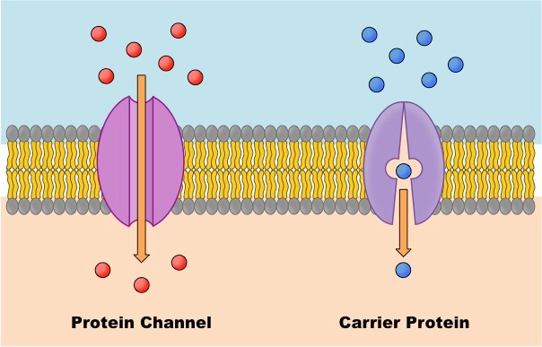

Slide 10
Protein Channels
To diffuse across a cell membrane, water-soluble molecules must pass through protein channels in the membrane, allowing facilitated diffusion.
Allows for hydrophilic particles to travel through to cross the cell membrane without touching hydrophobic portion of the membrane.
Protein channels are small (e.g. water and ions) but larger molecules cannot fit.

Slide 11
Carrier-mediated transport
Carrier proteins are only open on one side of the membrane at a time
When the specific substance binds to the binding site within the protein, the protein changes shape and opens to the other side.
The substance can then be released on the side opposite to where it entered.

Slide 12
Carrier-mediated transport
Carrier proteins are specific. They will only bind to a particular molecule
Carrier activity is regulated by substances such as hormones.

Slide 13
Carrier-mediated transport
There are two main types of carrier-mediated transport
Facilitated diffusion: occurs when substances are transported through a protein along the concentration gradient. During carrier-mediated facilitated diffusion the molecule to be transported e.g. glucose), attaches to the binding site on the specific carrier protein.
Active transport: requires energy (ATP) because substances are transported against the concentration gradient.

Slide 14
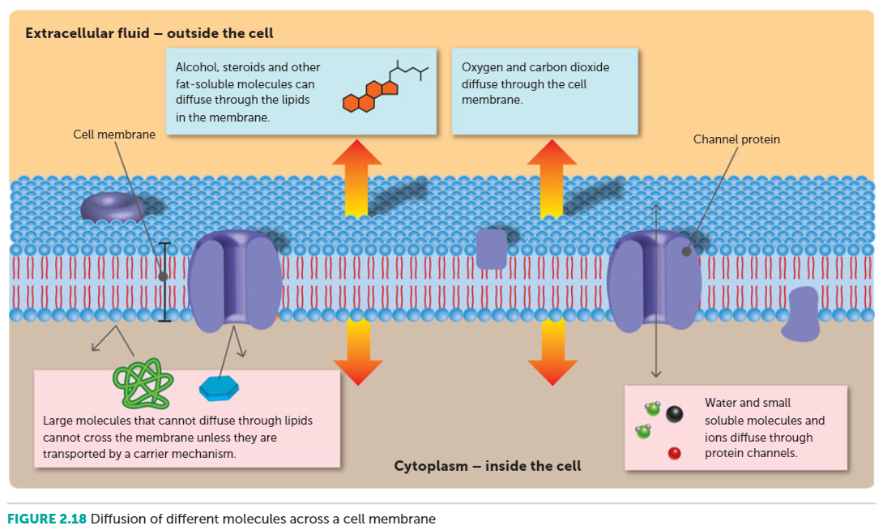
Copy this ☺

Slide 15
Vesicular transport
The movement of substances across the cell membrane in membranous sacs called vesicles.
This is an active process. Energy is needed to form the vesicle.

Slide 16
Endocytosis
Is taking liquid or solids into the cell by vesicular transport.
Cell membrane folds around a droplet of liquid or solid particle until the droplet is completely enclosed.
The vesicle then pinches off and is suspended in the cytoplasm.
Taking liquids into the cell this way is called PINOCYTOSIS.
Taking solids into the cell this way is called PHAGOCYTOSIS.

Slide 17
Exocytosis
When the contents of a vesicle inside the cell are passed to the outside.
A vesicle that is formed inside the cell migrates to the cell membrane and fuses with it.
The contents of the vesicle are then pushed out into the extracellular fluid.

Slide 18
Type of Transport | Passive or Active | Substances Transported
SIMPLE DIFFUSION
Simple diffusion of solute | Passive | Water, oxygen, carbon dioxide, alcohol, fatty acids, steroids, ions, lipids, soluble drugs
Osmosis | Passive | Water
FACILITATED TRANSPORT
Facilitated diffusion | Passive | Glucose, amino acids
Active transport | Active | Certain ions, glucose, amino acids
VESICULAR TRANSPORT
Endocytosis | Active | Cholesterol, iron ions, micro-organisms, cell debris
Exocytosis | Active | Secretions such as mucus or digestive juices

Slide 19
Microtubules
Very fine tubes that help to maintain the shape of the cell and hold the organelles in place.
They also act like railway tracks, guiding organelles or molecules, to particular places within the cell.
They are not permanent structures but are able to be broken down or built up as needed.

Slide 20
Recall Knowledge
Draw a labelled diagram of the fluid mosaic model of the cell membrane.
List three substances that a cell transports in.

Slide 21
Apply Knowledge
Compare and contrast the two types of carrier-mediated transport.

Slide 22
Homework
Explain why steroids are able to diffuse directly through the membrane, but glucose requires a carrier protein.

Slide 23
Reading
Pages 37 (bottom half) - 41 (top half of the page):
Facilitated Transport to Movement within the cell

